Slide 1

Anti-Cheating Enforcement System (A.C.E.S) GitHub Classroom Tutorial
Notes:
Welcome! this is the instructor tutorial for ACES. to use this program we will have to setup a github class room. So first we will show how to do that and then we will show how to use ACES. ACES requires the use of a unit test file to test the students code. As such you will need to have a repo created with starter code for each assignment you do. If you already have an organization setup in github you can skip to slide 4.

Slide 2
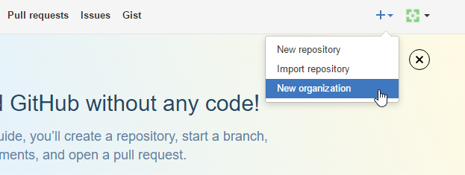
GitHub Classroom- Create Organization
Notes:
To create a github classroom we will need an organization. To create a organization when signed in to GitHub click on the “+” icon on the top-right corner and click on New Organization.

Slide 3
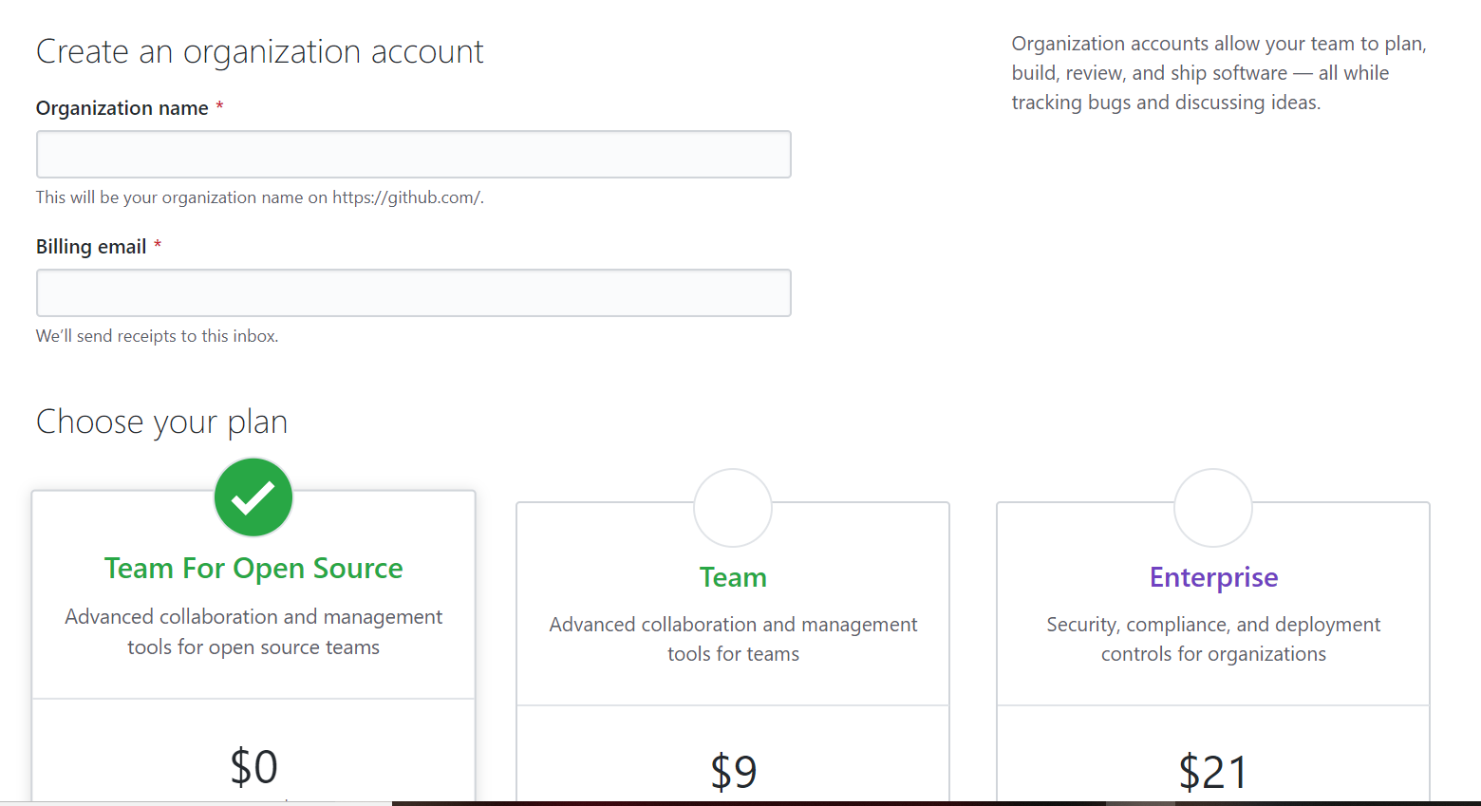
GitHub Classroom- Create Organization
A free account will work fine
Notes:
Give the organization a name and choose your plan type. A free plan will work fine for our purposes.

Slide 4
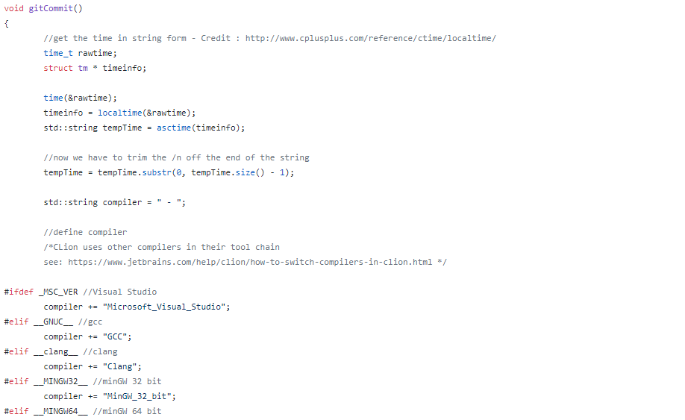
GitHub Classroom- Add Assignments
make sure your starter code includes the unit test file with the gitCommit() function there and running each time the student tests his program.
Notes:
ACES users a unit test file to grade the students papers. You create a unit test file with all the tests that will test the students code to make sure that it is working and include in that file a function called gitCommit(). the code for this function is included in thie repo for aces. just copy and paste it into your unit test file and run it as apart of the file with the unit tests. gitCommit() can be found in ACES_Cpp\ACES_Cpp\GitInterface.cpp in the aces repo.

Slide 5
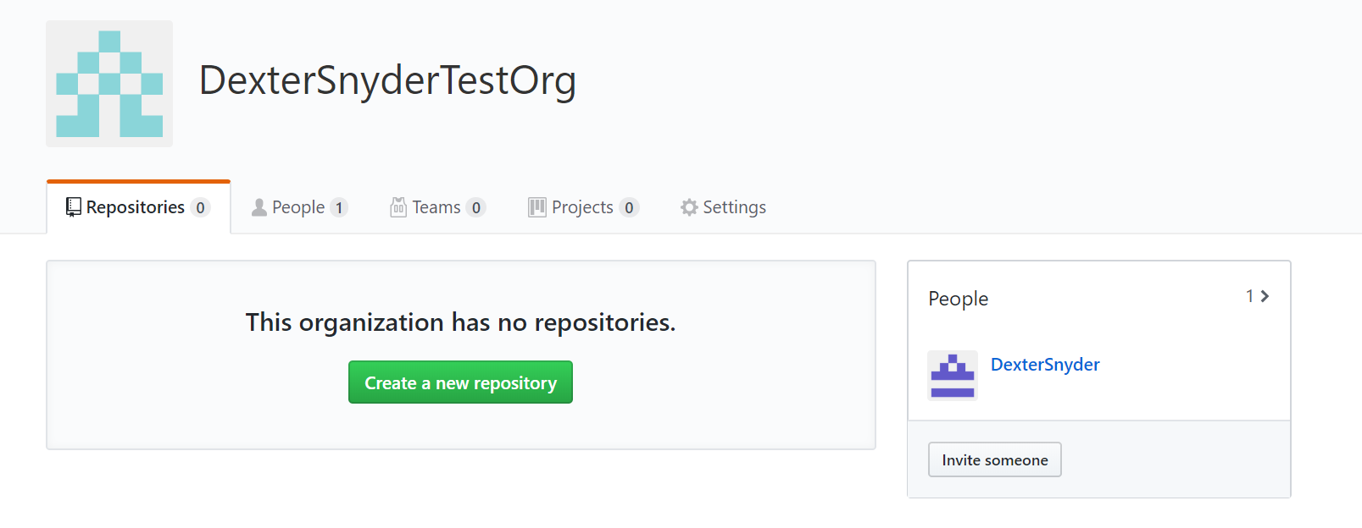
GitHub Classroom- Add Assignments
How you create a new repository depends on if you have an existing one or not. Make at least 1 before moving on.
Also, make sure to add *.opendb to the gitignore file, or Visual Studio will break the auto commit
Notes:
If you want to add your assignment starter code now you can or you can do this later at any time. make sure you have done this before createing the assignment in github classroom. When creating the starter code for your assignments make sure to add *.opendb to the gitignore file, or Visual Studio will break the auto commit. You can also add other admins to your organization to add other teachers.

Slide 6
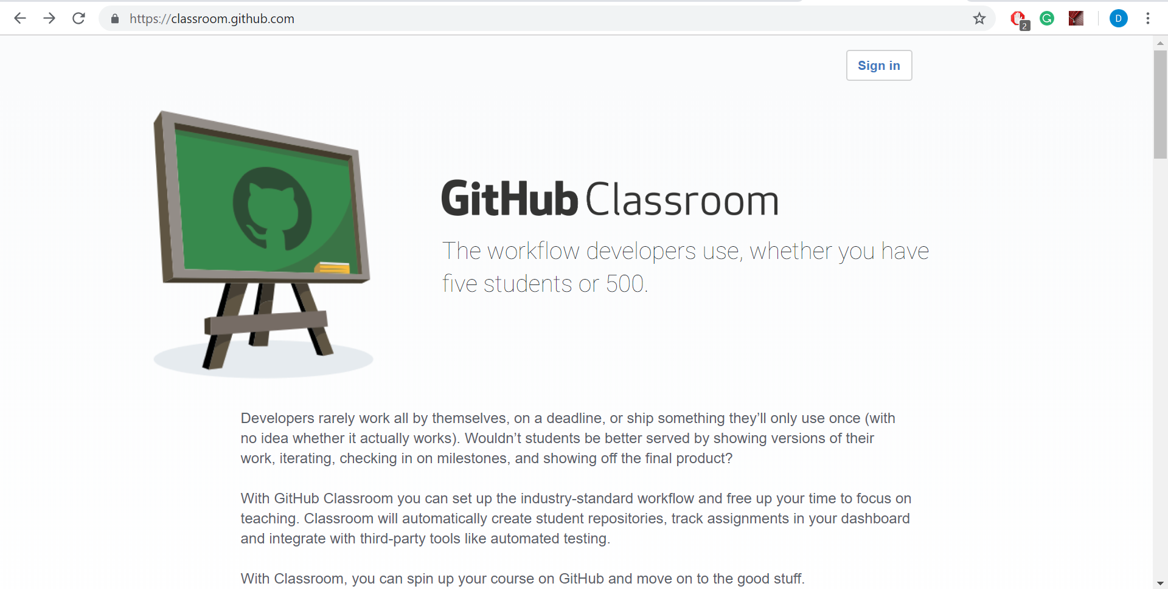
GitHub Classroom- Setup Class
Notes:
Now that the organization is created go to GitHub classroom at https://classroom.github.com/classrooms. Sign into GitHub classroom.

Slide 7
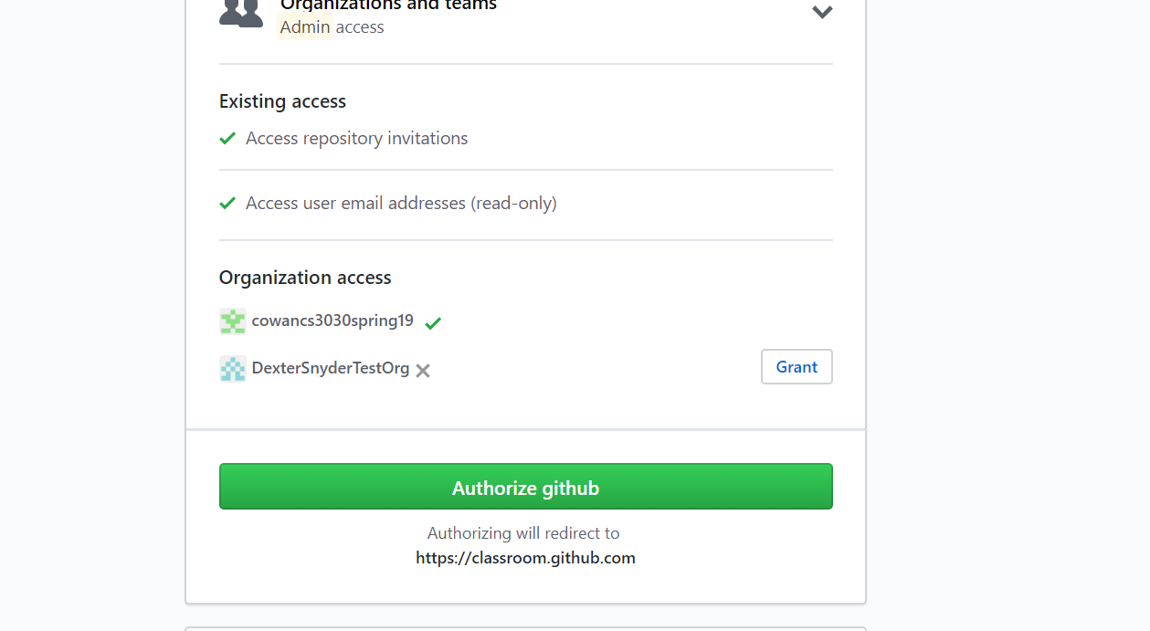
GitHub Classroom- Setup Class
Notes:
It will ask if you want to allow github to access GitHub classroom. click on Authorize GitHub.

Slide 8
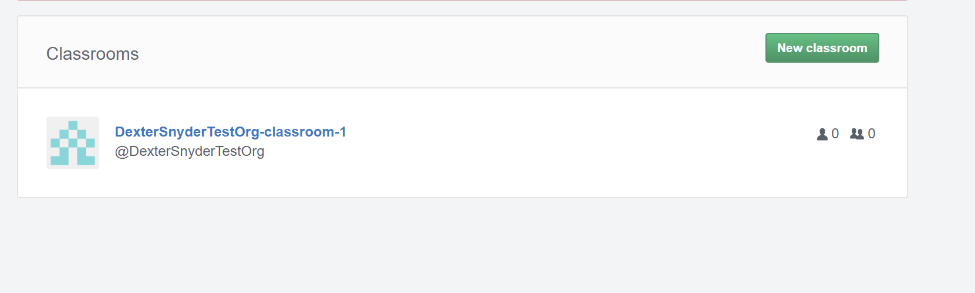
GitHub Classroom- Setup Class
Notes:
Next you will get a list of classrooms. at the top of the webpage you can create a new classroom, click on this now to create or classroom.

Slide 9
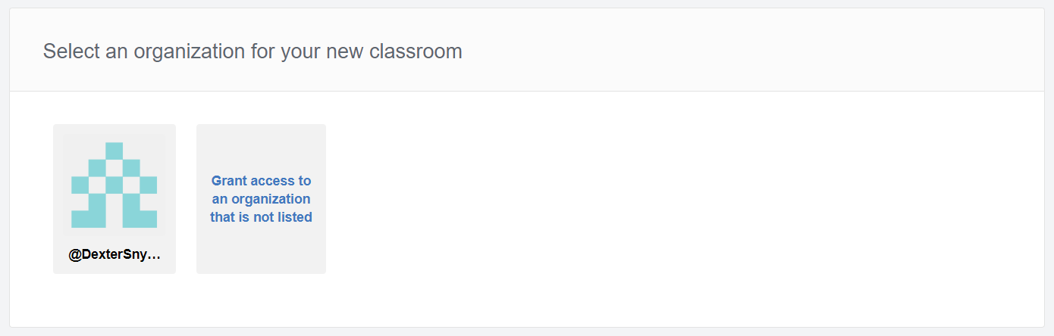
GitHub Classroom- Setup Class
Link to the organization that you created previously
Notes:
you will then be asked to link your classroom to an organization. link the new classroom to the organization that you created earlier.

Slide 10
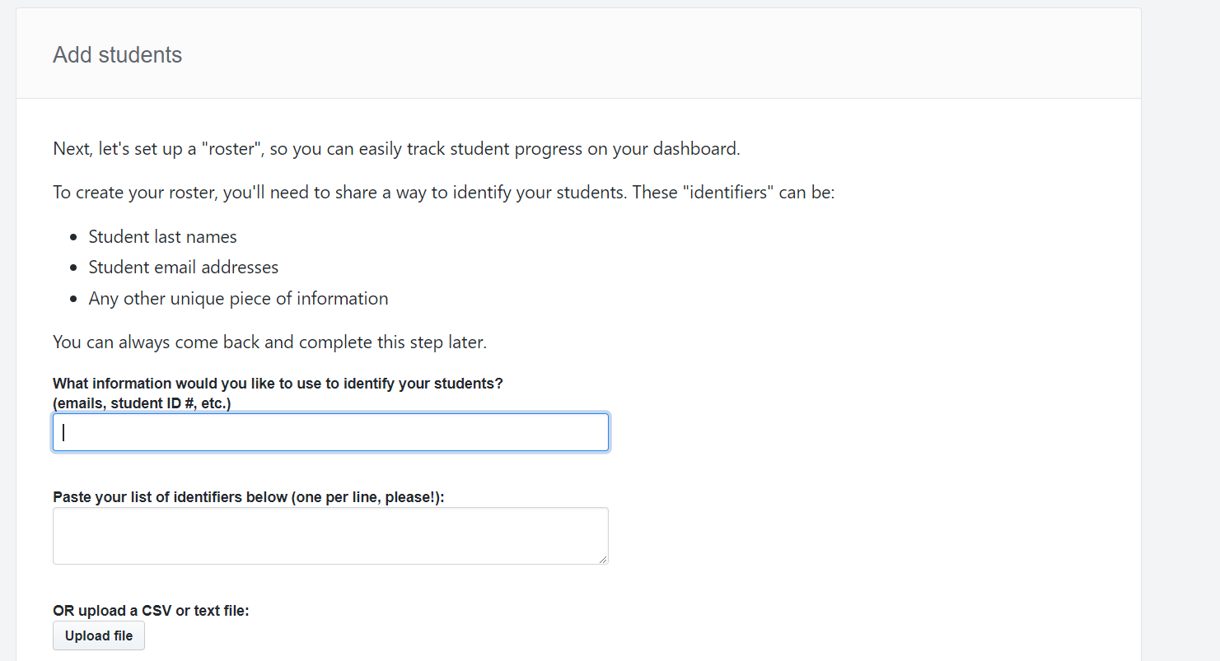
GitHub Classroom- Setup Class
Whichever identifiers you use will be how the students pick themselves off of a list
Notes:
now you will setup the class roster… first you set what the students will identify themselves by in the first field. then you will list the the students in the class by this id. for example. If you put “first name” in the in the top field then you would create a list of students first names in the second. later when the students access the first assignment they would choose their name from the list. Then classroom will attach there github id to this student in the roster.

Slide 11
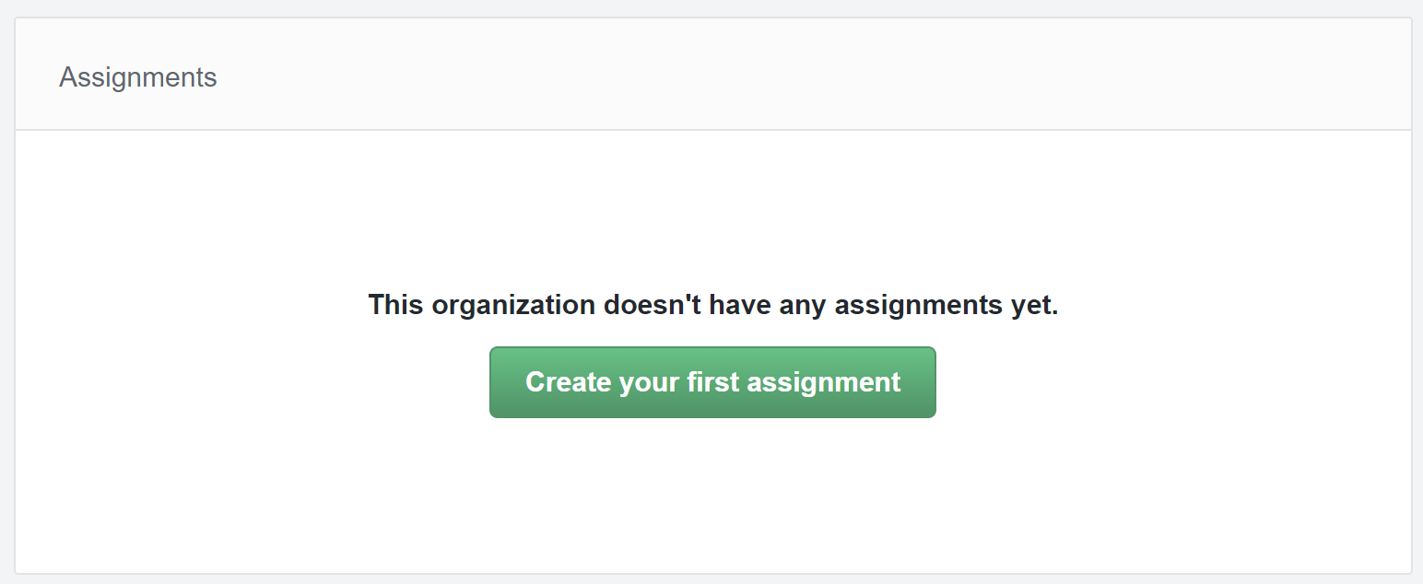
GitHub Classroom- Setup Class
Notes:
now that the classroom is created and the roster setup we can create our first assignment. in the center of the page is a button we can do this with. click on this button to create the first assignment.

Slide 12
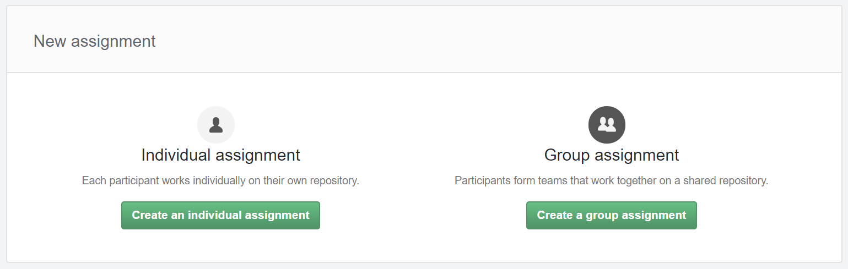
GitHub Classroom- Setup Class
Notes:
you cant create group assignments for individual assignments. for this tutorial we will choose individual assignment.

Slide 13
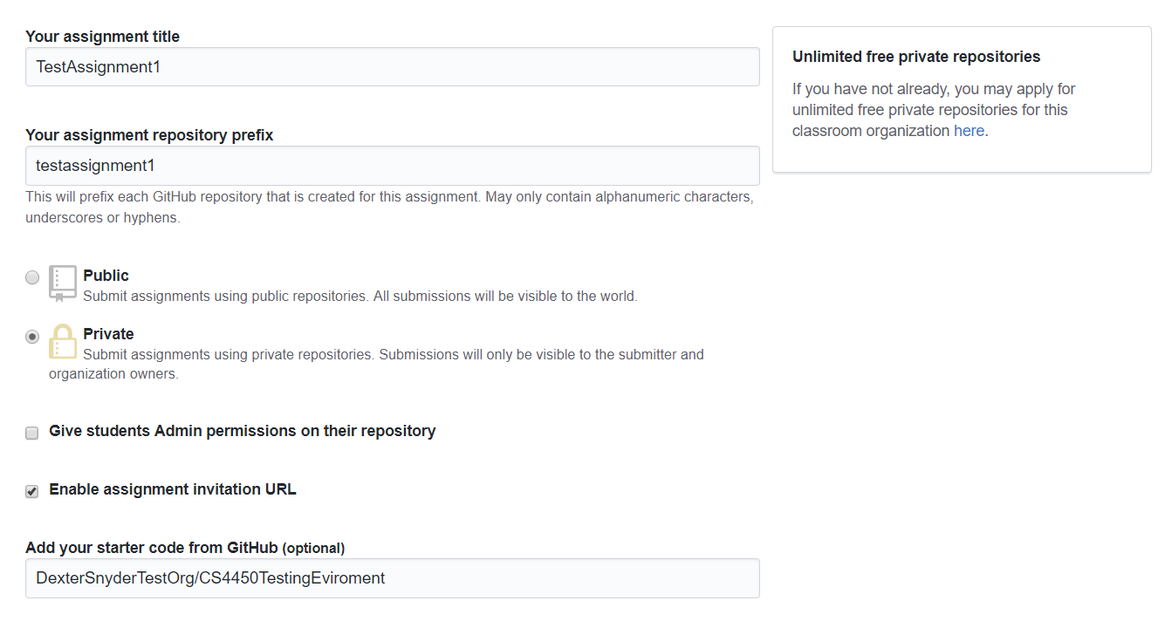
GitHub Classroom- Setup Class
Notes:
Now set the name of the assignment. this is where you will need the starter code. make sure you have created the unit test file in you starter code and that the gitCommit() function included with ACES is there. leave the repository prefix the same as the assignment name unless you want to enter the assignment repository prefix into the assignment name field in ACES. ASCS uses the Assignment name as the repository prefix to pull the student repos.

Slide 14
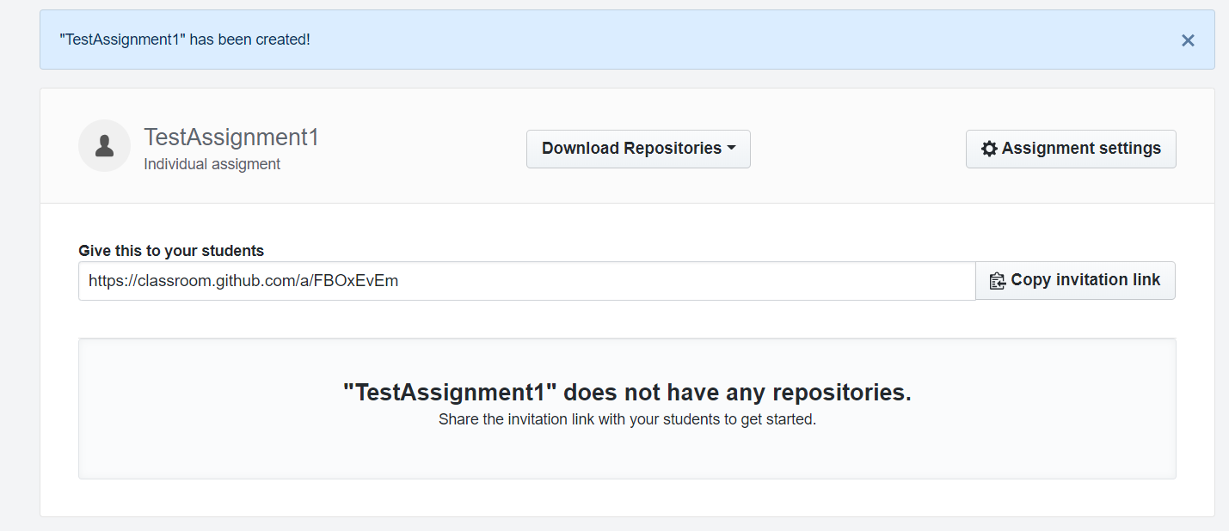
GitHub Classroom- Setup Class
Notes:
now we have created the classroom and the assignment. simply send the assignment url to the students. you can do this via e-mail to just post it to the assignment in canvas as it will be the same for all the students. when they click on it they will be told to choose there id on the roster then it will create a repo for them using the starter code and they can clone the repo to there computers to work on it. the gitCommit() function will record their testing and commit each time they test their program.

Slide 15
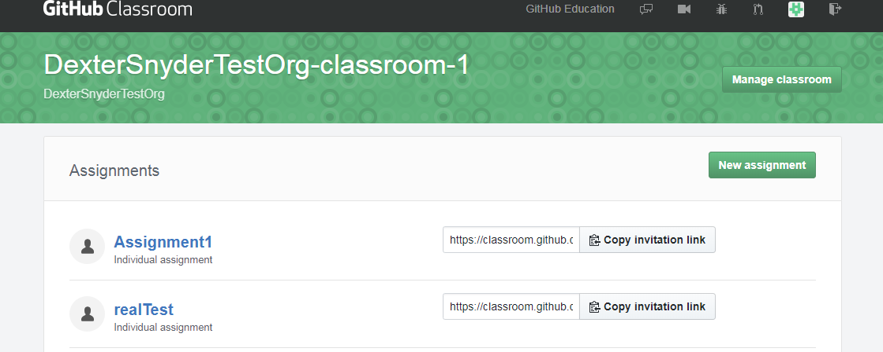
GitHub Classroom- Manage Class
Notes:
Once the students have all downloaded the assignment and the due date has been reached and they have pushed their assignments back to github it is time to run ACES. first go back to the classroom and click on manage classroom.

Slide 16
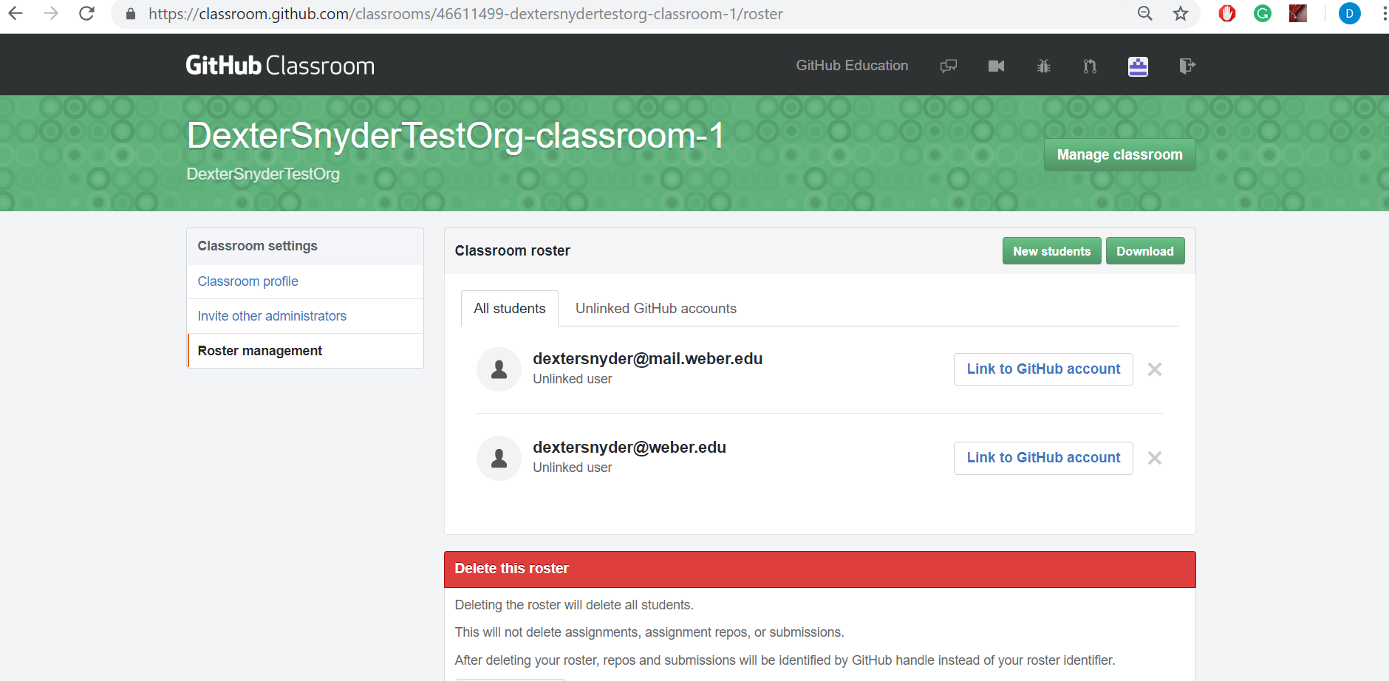
GitHub Classroom- Manage Class
Manage students here
Notes:
Then click on Roster Management. this will bring us to this page. now that your students have all set there ids to the repos and github accounts you can click on download. this will download the github ids and roster ids for all the students in the class in a csv file. you will need this when creating the call in ACES.

Slide 17
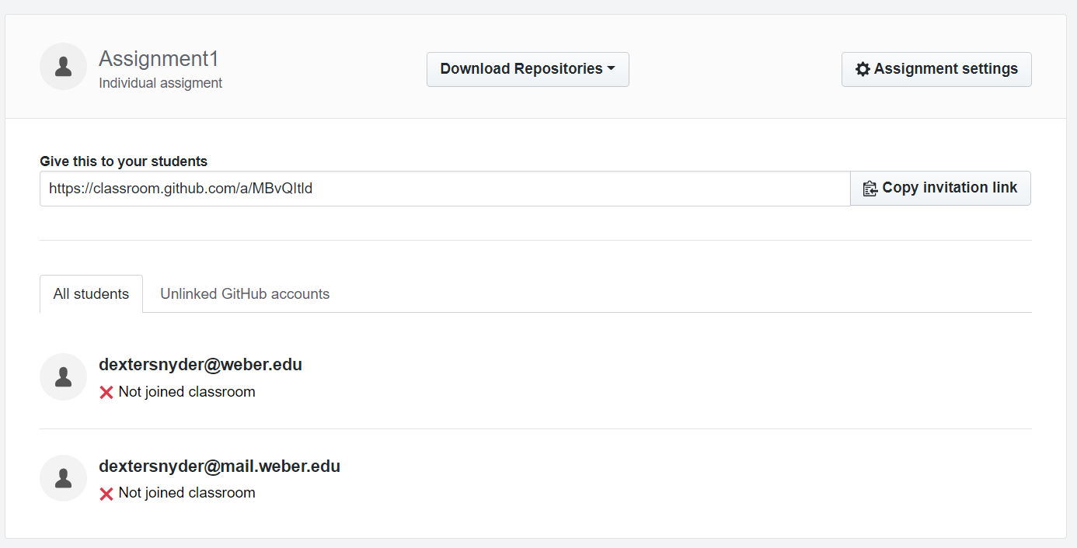
GitHub Classroom- Manage Class
Notes:
If the student has not started the assignment or added themself to the roster via clicking on there id in the roster they will not show up in ACES. this is what it looks like in the assignment when the student has not added himself to the roster yet.

Slide 18
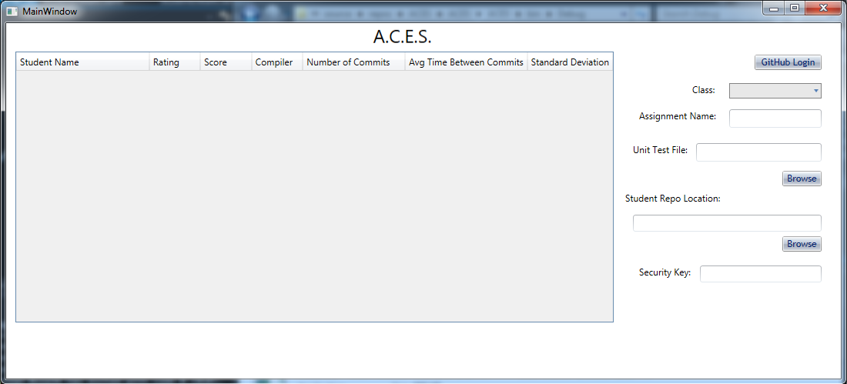
ACES - using ACES
Notes:
Now we can start using ACES. first we open aces and this is the screen we will be presented with. we cant do anything untill we login to gitbub. so we will start by clicking on the github login button.

Slide 19
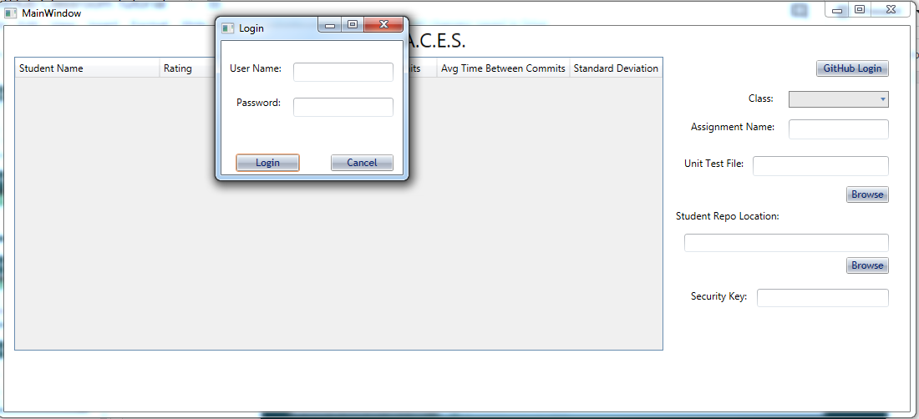
ACES - using ACES
Notes:
This will pull up the login window. put in you username and password. this will give you a success message when you successfully login.

Slide 20
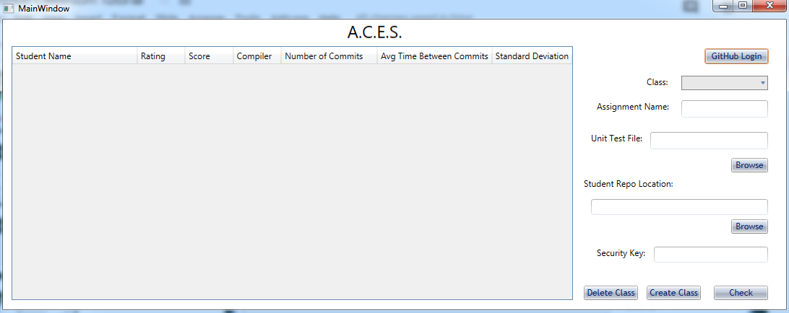
ACES - using ACES
Notes:
This will show three new button we will now import our github classroom. into ACES. To do this click on create class.

Slide 21
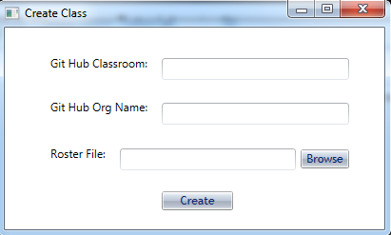
ACES - using ACES
name of class you choose.
Organization created earlier in the tutorial.
path to roster file that was downloaded earlier in this tutorial.
Notes:
This will show the create class window. the first thing we will need is the name you want to use in the classroom dropdown. this is used to choose the class you are pulling the info for. this can be anything it is only used in the drop down so you can tell the difference between classes you are grading assignments for. the second field is the organization that is attached to the classroom. this is used in github to as a part of the repo url. so you will need to match this exactly. the last field is the path to to roster file that we downloaded previously. the browse buttion will allow you to simply select the roster file in file explorer. when all three feilds are populdated hit create.

Slide 22
ACES - using ACES
Notes:
This bring us back to the main window. click on the class dropdown and you will see the name you chose for the class. This info will be saved so that if you close and reopen ACES the class will still be in the dropdown. to remove a class from the drop down simply select the class then click on the delete class button. you may need to do this if someone did not link there github account then later did.

Slide 23
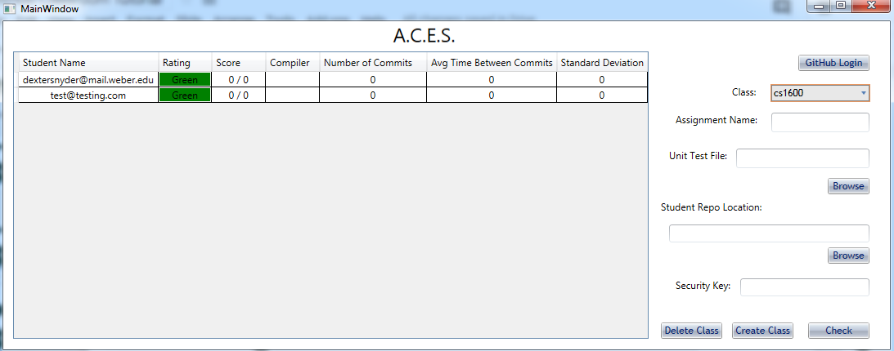
ACES - using ACES
Notes:
Once you select a class the student roster grid will automatically populate on the students with zeros for scores as they will not have been tested yet. now put the assignment name in the Assignment Name text box. if you changed the assignment repository prefix in assignment creation process you will need to put the assignment repository prefix into this field in ACES instead of the name as it uses this info to pull the repos of the studnes to test them.

Slide 24
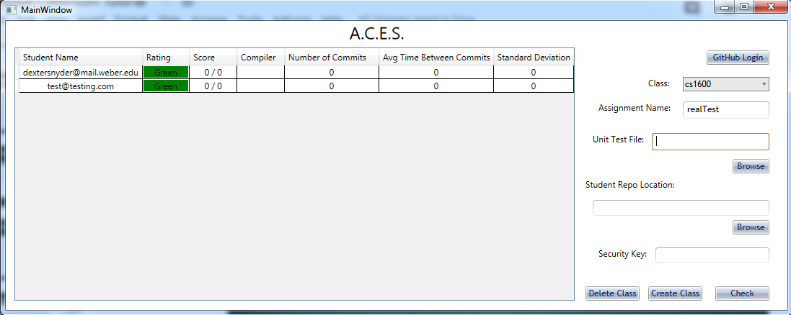
ACES - using ACES
Notes:
this will be an instructor version of the unit test file. this version does not require the getCommit() function be dose require a code added to the tests. this is added by adding: std::string securityCode = “23456”; to the top of the file under the using commands. changing out 23456 with whatever code you wish to use. use the browse button to simply select the file.

Slide 25
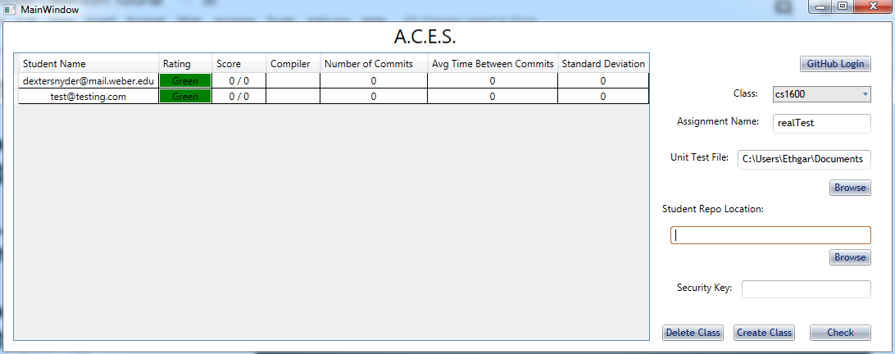
ACES - using ACES
Notes:
this is a folder on your computer. ACES will clone all the student repos to your computer into this folder and then run the instructor test on them to validate their scores and analyze if they were cheating or not. it will then display this info on the student grid. so simply find a folder on you system that you would like to use to clone all the repos into and add it here.

Slide 26
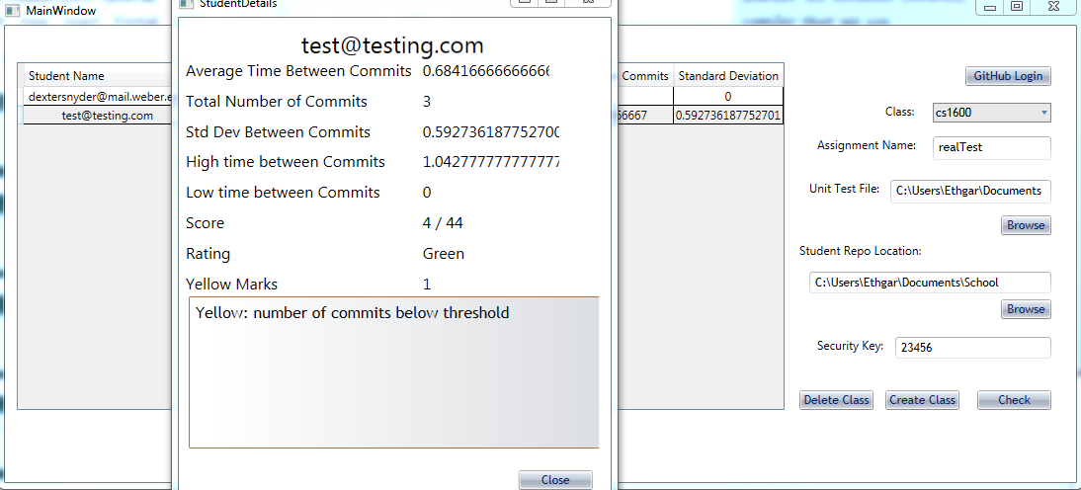
ACES - using ACES
Notes:
The student info window shows all the info for the user and why the user got the cheating rating that they got. with all the flags that aces cought in the code. in this case the student only had three commits. this is too few tests for a full program, but they ony passed 4 tests so not much work must have been done. you can also see the highest time between commits and the lowest.

Slide 27
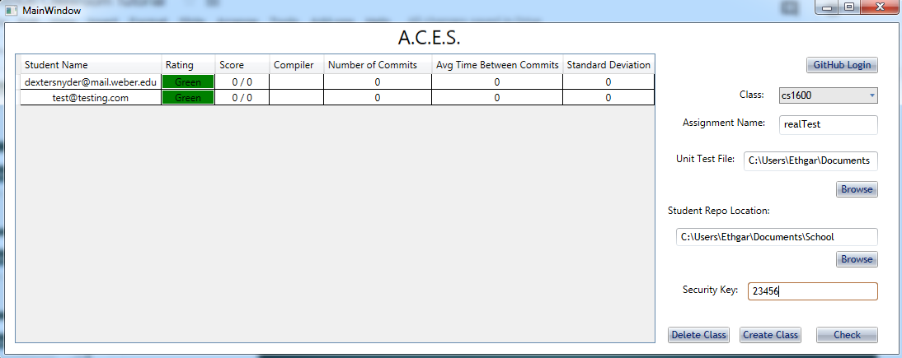
ACES - using ACES
Notes:
now that the class room is added the students have turned in there assignments and all the data has been added to ACES. It is now time to run the tests. simply click on check and it will clone all student repos and run the unit tests on them. it will then analyze all the data and flag any suspicious behavior. It will take a few minutes to complete.

Slide 28
ACES - using ACES
Notes:
now that the class room is added the students have turned in there assignments and all the data has been added to ACES. It is now time to run the tests. simply click on check and it will clone all student repos and run the unit tests on them. it will then analyze all the data and flag any suspicious behavior. It will take a few minutes to complete.

Slide 29
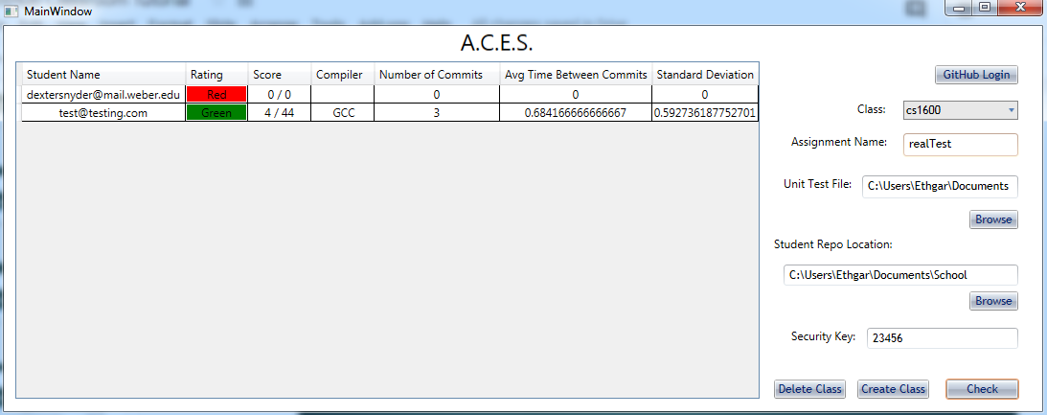
ACES - using ACES
Notes:
this is what it looks like when it is done with the test. it will show the rating of all the students and their scores. this test case shows a class of three students. the first is not registered on github classroom so doesn't show up at all. the second is registered on the roster but has not cloned the assignment yet and show shows have having a zero. the last has cloned the assignment and done some work. he only has a score of 4/44 and 3 tests on his code so he has not gotten very far though. it shows that he is using GCC to compile his code and the average time between commits for this 3 commits. this is in hours. it also shows the standard deviation of his commit time. the rating shows as green so he has no flags showing that he cheated therfore showing that he did not cheat.. to get a closer look at his info we can double click on his row.

Slide 30
ACES - using ACES
Notes:
this is what it looks like when it is done with the test. it will show the rating of all the students and their scores. this test case shows a class of three students. the first is not registered on github classroom so doesn't show up at all. the second is registered on the roster but has not cloned the assignment yet and show shows have having a zero. the last has cloned the assignment and done some work. he only has a score of 4/44 and 3 tests on his code so he has not gotten very far though. it shows that he is using GCC to compile his code and the average time between commits for this 3 commits. this is in hours. it also shows the standard deviation of his commit time. the rating shows as green so he has no flags showing that he cheated therfore showing that he did not cheat.. to get a closer look at his info we can double click on his row.

Slide 31
ACES - using ACES
Notes:
After closing aces and reopening it. The tool will remember all the classes you add to it so that you don't have to re add them every assignment. you just have to add the new assignment info and run the check again. this will finish our tutorial for how to use ACES.

